Slide 1
Impact of Liquidity Pool Size on Trading Volume in BTC-ETH Pools
Team 111: Vitor de Matos Castilho
Walter Jack Simmons
Matias Vizcaino

Slide 2
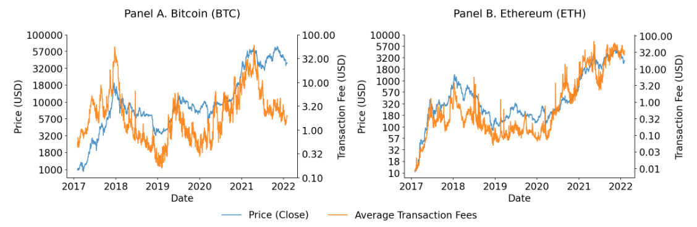
Background
ETH and BTC Price Movement
- Decentralized Finance (DeFi): Open-source, 24/7 financial system leveraging blockchain technology, mainly Ethereum, for transparent data and accessibility.
- Traditional vs DeFi: DeFi's 24/7 operation and instant transactions contrast traditional finance's intermediaries and banking hours. Notably, DeFi carries more risk due to its unregulated nature.
- Liquidity Pools: Shared funds in DeFi enabling seamless trading. Users contribute to these pools and earn trading fees.
- Uniswap: A key DeFi player, Uniswap uses an innovative market maker model on Ethereum. Our focus is on WBTC-WETH pools due to their significant liquidity and volumes.
Employing data engineering and predictive modeling, we analyze diverse data, select key features, evaluate risks, and apply mathematical equations.
Our work serves as an open framework for continuous research in this rapidly evolving field.
Makarov, I., & Schoar, A. (2022). Cryptocurrencies and Decentralized Finance (DeFi). In BPEA Conference Drafts, March 24-25, 2022. Retrieved from https://www.brookings.edu/wp-content/uploads/2022/03/SP22_BPEA_MakarovSchoar_conf-draft.pdf

Slide 3
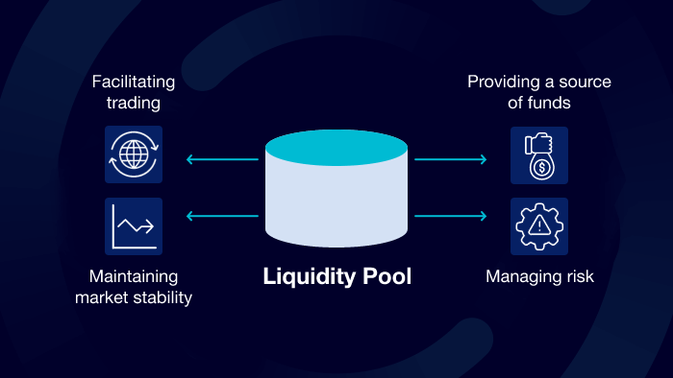
Literature Review: Key Takeaways
LeewayHertz. "What are Liquidity Pools?" Retrieved from https://www.leewayhertz.com/what-are-liquidity-pools/
Our study is primarily modeled after “Modeling and Forecasting Trading Volume on Uniswap v3 Liquidity Pools” (Miori, 2023).
1. Uniswap & Liquidity Pools: Central to DeFi, liquidity pools on Uniswap enable efficient trading (Miori, 2022; Aigner, 2021). Uniswap v3's refined CPMM model optimizes capital usage (Elsts, 2021).
2. WBTC-WETH Pools: WBTC-WETH pools are of interest due to large trading volume/liquidity (Heimbach, 2022).
3. Spillover Effects: Centralized exchanges like Binance can influence DEXs trading volume (Miori, 2023).
4. Methodologies: Research employs regression models (like OLS) to analyze liquidity pools, with suggestions for future non-linear models and exploration of additional factors (Miori, 2023; Makarov, 2022).

Slide 4
Problem Statement
The impact of liquidity injection into decentralized exchange (DEX) pools, particularly BTC-ETH pools on Uniswap, on trading volumes is not well understood. This gap extends to understanding the interplay between different DEX pools and the potential spillover effects from centralized exchanges. This lack of clarity hinders optimal decision-making for stakeholders in the DeFi ecosystem.
Hypothesis
We anticipate that increased liquidity injections into DEX pools will positively correlate with trading volumes.
Furthermore, we expect inter-effects across different DEX pools and significant spillover effects from centralized exchanges.
Our research aims to quantify these effects and provide actionable insights and code for liquidity providers, traders, and platform architects in DeFi.
Notes:
By studying this relationship, we contribute to the efficient functioning of DeFi markets, optimizing strategies for participants, and influencing the allocation of capital within the ecosystem.

Slide 5
Analytical Methodology I
From data collection to analysis, our rigorous approach, modeled after existing research, led to valuable insights and confirmed published results.
Steps | Description
Data Collection | Used Uniswap, Etherscan and Binance APIs
Data Preprocessing | Ensured data consistency and handled missing values
Exploratory Data Analysis (EDA) | Identified trends and relationships
Features & Model Construction | Leveraged innovative feature engineering and constructed robust predictive models for a deeper understanding of liquidity pool dynamics
Final Analysis and Conclusions | Offered quantitatively-driven insights
Confirmation of Results | Largely aligned with reference paper

Slide 6
Analytical Methodology II
We leveraged advanced techniques, created new features, and applied Python for robust data modelling
Utilizing this framework, we are able to answer our problem statement and also provide avenues for future exploration. This open framework and code could provide an excellent foundation for future research.
Techniques | Description
Feature Engineering | Enhanced models with new features
Modelling and Optimization | Used OLS regression for deep insights
Innovations | Python code for effective modeling of temporal features on liquidity pools

Slide 7
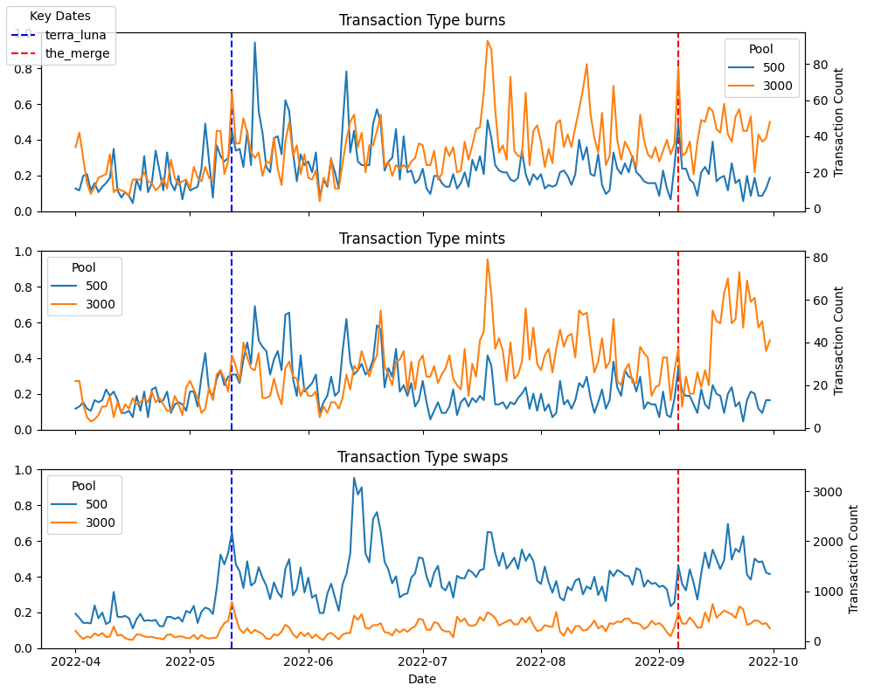
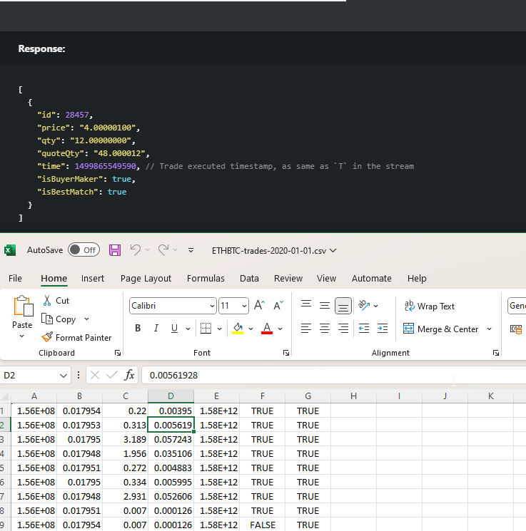
Data Overview
Uniswap Activity by Transaction Type
Timeframe: April 1, 2022 - September 30, 2022.
Key events: Terra-Luna collapse (July 20, 2022) and The Merge (September 6, 2022).
The Graph API: Uniswap³
Transaction details, trading volumes, and block information from Uniswap v3 liquidity pools
Focus on WBTC-WETH for fee tiers 500 and 3000
Etherscan API⁴
Transaction data based on translation hashes
Block hashes, block numbers, sender addresses
Binance CEX Data⁵
Daily zip trades downloaded from Binance GitHub
Trade prices, quantities, timestamps
Binance Data Download

Slide 8
Key Variables
Target Variable: Trading volume of liquidity pools (amountUSD) over specific blockchain horizons (i.e., one horizon equivalent to ~10 blocks).
Independent Variables:
CEX Direct Pool Features: Includes volatility, rate, number of trades, and average trade size; Lagged variables extend coverage up to 3 trading clocks in the past.
DEX Spillover Effects: Variables that influence pools but not directly related to our pools.

Slide 9
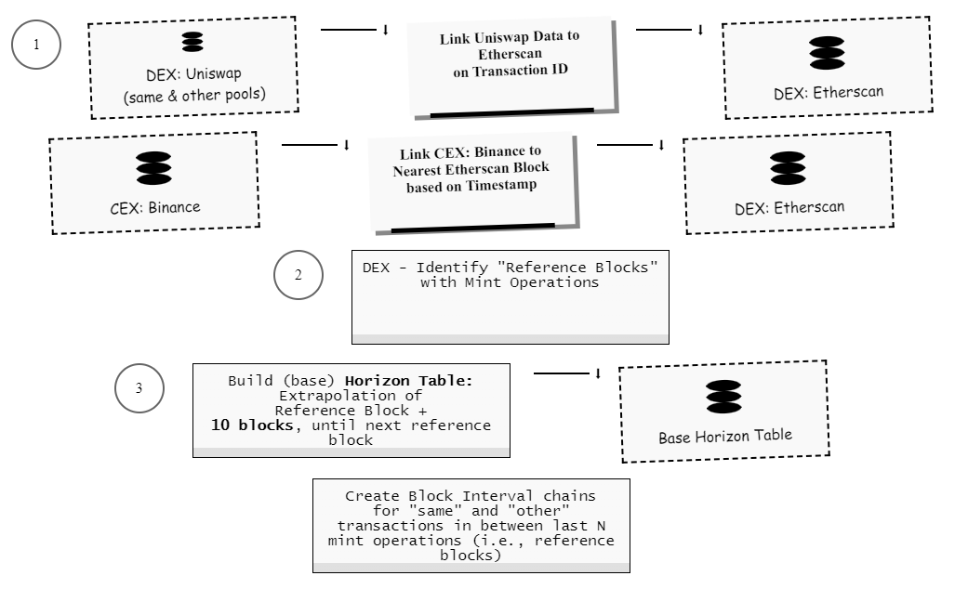
Feature Engineering (1 of 2)
Data Engineering
1. Pool Selection:
Pools: WBTC-WETH exchange with p∈P={500,3000,both}.
Introduced reference pool Pr​, where Pr​∈P and Pr ≠ both.
2. Reference Blocks:
Identified by the presence of a mint operation.
Consolidation of mints from the same block into a single transaction for each pool.
3. Block Interval Chains (DEX data) and Horizon Table (Block time series):
Built Block Interval Chains for "same" and "other" reference pools
Built a Horizon Table for each reference mint (refbase, ref500, ref3000).
Time horizons, which represent future periods are constructed from the first reference block and increasing the block count until the next reference block is reached.

Slide 10
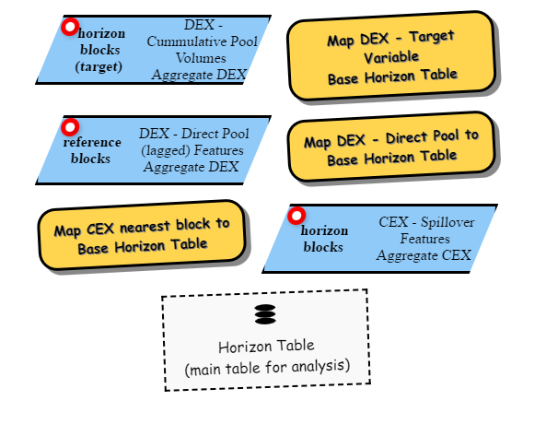
Feature Engineering (2 of 2)
Features & Granularity Levels
4. Target Variables (DEX data):
Defined as the cumulative volume for a pool at a given horizon: cum_volume_500, cum_volume_3000, and cum_volume_base.
Logarithmic transformation using base 10
5. Feature Variables (DEX direct pool + CEX spillover):
Calculated at both the reference block level and the more granular horizon block level, allowing us to capture the state of the ecosystem at the beginning of the horizon (reference block) and how it evolves over time (horizon block).
6. Horizon Table – Main Table for Analysis:
Diagram illustrates mapping of feature variables to respective horizon or reference block.
Horizon Table aggregates these features and targets, serving as 118,785 horizons the primary resource for our analysis.
Component | Granularity Level
DEX target variable | Horizon block level
DEX direct pool features | Reference block level
CEX spillover features | Horizon block level

Slide 11
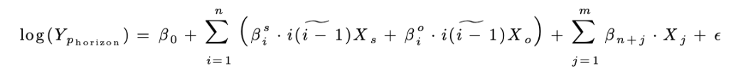
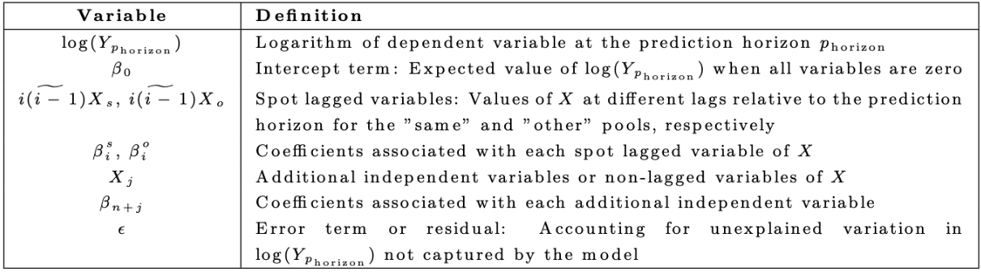
Time Series Analysis via Ordinary Least Squares (OLS) Regression
Choice of Model:
OLS regression was chosen for simplicity, interpretability, and comparability with other academic works.
OLS is a widely accepted method in econometric and financial analysis, allowing for easy comparison and discussion of our findings with existing literature.
Purpose of Analysis:
Studying the correlation between the size of liquidity pools and trading volume.
Time-series data believed to follow a linear trend, considerations autocorrelation and non-stationarity.

Slide 12
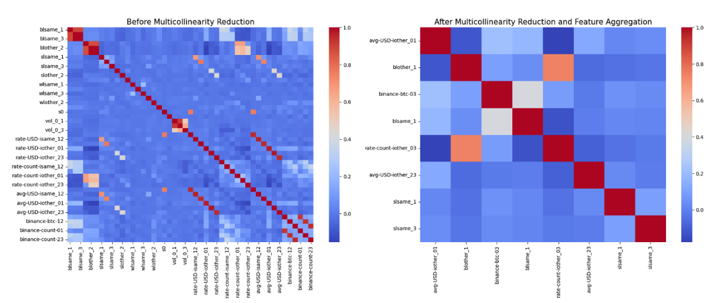
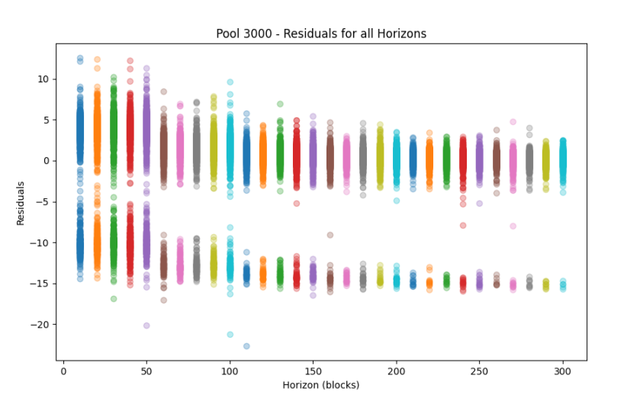
Data Management and Analysis Process
1. Data Cleaning and Preparation:
Addressed missing values, removed highly correlated columns, and aggregated similar columns.
Ensured data integrity with minimal data loss (0.09%).
Correlation Matrix & Residual Analysis
2. Multicollinearity and Feature Selection:
Utilized correlation analysis, Variance Inflation Factor (VIF), and a step-wise feature selection process to ensure model robustness and significance of features.
3. Residual Analysis:
Identified and corrected heteroscedasticity through error term distribution analysis and logarithmic transformation of response variables.
42
26
Observations:
Noted potential underprediction and overprediction in the residual analysis.
The rigorous process led to robust and effective analysis, addressing major concerns.

Slide 13
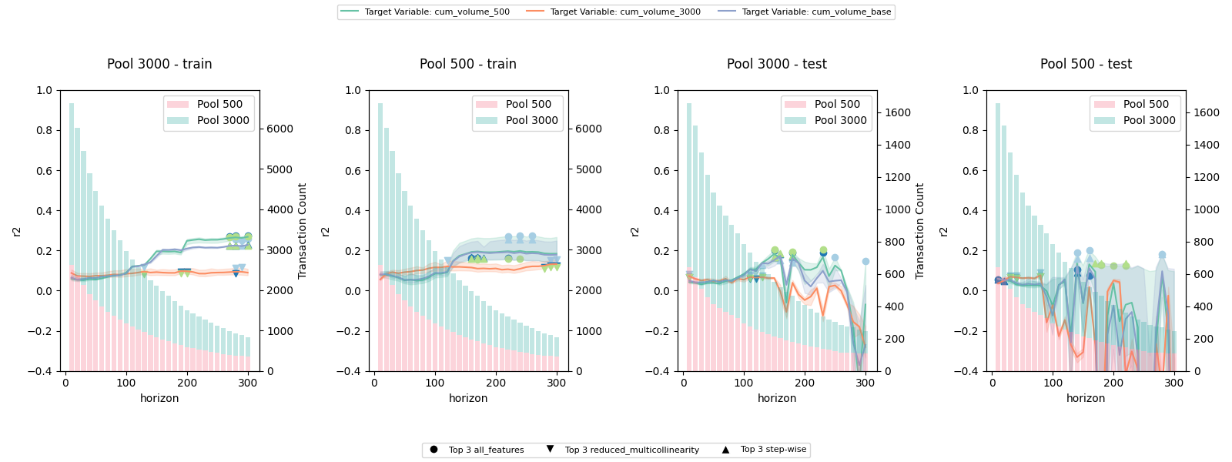
Model Evaluation & Optimization
1. Model Evaluation: Utilized GroupKFold to assess performance and overfitting, with R-Squared and Adjusted R-Squared as key metrics.
2. Model Optimization: Iterative approach with "All Horizon Runs" and "Best Horizon Run" stages. Identified 'step-wise' model as optimal for specific target variables and horizons.
Observations:
Model performance generally declines with increasing prediction horizons. However, our 'step-wise' model consistently delivers high R² values across various horizons, indicating its resilience against these challenges.
Despite some models demonstrating overfitting, our 'step-wise' model, particularly with the cum_volume_500 target in the '3000' pool, exhibits strong performance on unseen data.
Notes:
Hello , ladies and gentlemen, I'm and I will be presenting the final part of this project.
We start with the model evaluation and optimization.
In this slide, you can see to the right a series of plots.
These plots compare the different Rsquared obtained from models ran on:
all the features,
on the reduced set of predictors left after removing those with high multicollinearity
and finally those obtained after running a stepwise regression.
Still in the plot you can see a comparison between the different pool sizes and also between train and test sets.
What can be observed in the test set, is that the test set its response becomes unstable above 200 horizons
and for that reason a more stable period was selected at horizon 150.
Finally, this plot allows us to determine the best Rsquared between the models at the selected horizon. That being the Stepwise having the cummulative volume for the pool 500 as dependent variable.

Slide 14
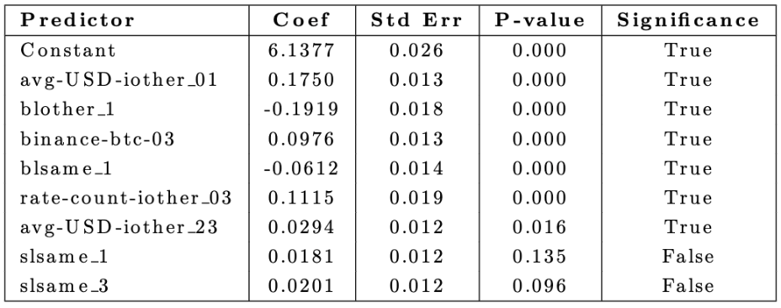
“Best Model” Results & Interpretation
Our best model (stepwise, pool=3000, target = cum_volume_500, horizon = 15) shows a significant overall relationship with F-statistic = 57.38, p < 0.001.
The model explains (R-squared value) 23.8% of the variance in the target variable (log of 'cum_volume_500’), considered a good proportion given the complexity of the data and aligns with results from previous studies.
Predictor Interpretation:
A mint operation in the 'same' pool (3000) triggers effects on the cumulative volume in the 'other' pool (500).
Each predictor corresponds to a change in the log of cum_volume_500 for a one standard deviation increase in the respective predictor.
Interpretation of significant predictors reveals dynamics between pools and other factors.
Notes:
In this slide we show the coefficients obtained after running the best model selected in the previous step.
An Rsquare of .238, therefore about 24% of the variance in the response variable is explained by the independent variables in this model.
A total of 8 predictors is what is left after running this stepwise regression. The table shows that 6 of these have statistical significance.
Each predictor corresponds to a change in the log of cum_volume_500 for a one standard deviation increase in the respective predictor.
The first predictor in the table shows a positive coefficient, indicating a direct relationship between added liquidity to a pool 3000 and the cummulative volume on the other pool, in this case, 500.
Hence, a mint operation in the pool (3000) triggers effects on thecumulative volume in the 'other' pool (500).

Slide 15
Key Findings & Conclusions
1. Significant Predictors:
Higher immediate trading activity in the 'other' pool increases cumulative volume.
Reduced minting frequency in 'same' and 'other' pools leads to lower cumulative volume.
Increased BTC trading volume on Binance correlates with increased cumulative volume in the 'other' pool.
2. Insights & Implications:
Our findings confirm a direct correlation between liquidity pool size, mint frequency, and trading volumes.
We also observe a significant spillover effect from centralized exchanges to decentralized exchange pools.
These insights offer strategic guidance for liquidity providers, traders, and architects of decentralized exchanges.
Run Parameters for Replicability
Run | Pools | Target Variables | M | T | K (CV)
Best Horizon | 3000 | cum_volume_500 | 10 | 3 | 5
All Horizon | 3000, 500 | cum_volume_500, cum_volume_3000, cum_volume_both | 10 | 3 | 5
Future Research Recommendations
Investigate high VIF variables for new insights.
Consider non-linear models.
Explore DeFi dynamics and associated risks.
Optimize model parameters.
Refine model by adjusting lags and including quadratic features.
Analyze recent events for updated understanding of DeFi.
Notes:
So we now move to key findings and conclusions.
From our model we learn that higher immediate trading activity in one pool directly relates to increases in cumulative volume in other pools.
Our findings confirm a direct correlation between liquidity pool size, mint frequency, and trading volumes.
These insights offer strategic guidance for liquidity providers, traders, and architects of decentralized exchanges.
As future steps in this effort, there is room to improve the Rsquared and for that we can recommend
to further investigate multicollinearity on the remaining variables
trying non-linear models
optimizing model parameters, amongst others.

Slide 16
References
Andreas A Aigner and Gurvinder Dhaliwal. Uniswap: Impermanent loss and risk profile of a liquidity provider, 2021. https://github.com/atiselsts/uniswap-v3-liquidity-math/blob/.
Atis Elsts. Liquidity math in uniswap v3 technical note, 2021.
https://github.com/atiselsts/uniswap-v3-liquidity-math/blob/.
Lioba Heimbach, Eric Schertenleib, and Roger Wattenhofer. Risks and returns of uniswap v3 liquidity providers. 2022.
http://arxiv.org/abs/2205.08904http://dx.doi.org/10.1145/3558535.3559772.
Igor Makarov. Cryptocurrencies and decentralized finance (defi), 2022.
Deborah Miori, Mihai Cucuringu. Defi: data-driven characterisation of uniswap v3 ecosystem an ideal crypto law for liquidity pools. 2022.
http://arxiv.org/abs/2301.13009.
Deborah Miori and Mihai Cucuringu. Defi: modeling and forecasting trading volume on uniswap v3 liquidity pools, 2023.
https://ssrn.com/abstract=4445351
Note: This project is inspired by the above paper, from which the main methodology is borrowed, replicated, and expanded.
Jiahua Xu and Yebo Feng. Reap the harvest on blockchain: A survey of yield farming protocols. IEEE Transactions on Network and Service Management, 20:858–869, 3 2023.
http://dx.doi.org/10.1109/TNSM.2022.3222815
Notes:
The references used in this effort are listed on this slide.

Slide 17
References
binance-public-data. https://github.com/binance/binance-public-data/blob/master/python/README.md
etherscanapi. https://api.etherscan.io/api
Uniswapapi. https://api.thegraph.com/subgraphs/name/uniswap/uniswap-v3
Matias Vizcaino, Walter Jack Simmons, and Vitor de Matos Castilho. Data extracted and cleansed.
https://drive.google.com/drive/folders/1y5ZwLZK9GQYsCNYSY--4VQMg80dnuwuU?usp=sharing.
Note: The dataset used in this project was obtained through data extraction and cleansing processes.
Matias Vizcaino, Walter Jack Simmons, and Vitor de Matos Castilho. Team111repo.
https://github.gatech.edu/MGT-6203-Summer-2023-Canvas/Team-111.
Note: The GitHub repository associated with this project contains the code and additional details.
Datasets & Code
Notes:
Finally, datasets and code can be found on the links shown.
Thank you.

